Slide 1
The classification of data professionals’ salaries based on results from an online survey
with Rushil Umaretiya and Utkarsh Goyal

Slide 2

Meet Brent Ozar
I make Microsoft SQL Server go faster. I got my start in the late 1990s – first as a developer and systems administrator, then as a full time DBA. I’ve managed performance and reliability for truly tough servers: tens of terabytes, thousands of databases, thousands of queries per second.
I’m one of the rare Microsoft Certified Masters, and I’ve taught at conferences around the world including the PASS Summit, SQLbits, SQL Intersections, and Microsoft Ignite. My clients have included Stack Overflow, Google, and other companies whose SQL Servers you rely on every day.

Slide 3
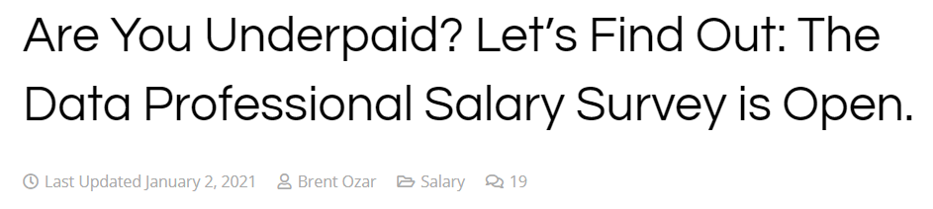

Notes:
Our dataset consisted of raw responses from a survey that Brent Ozar, SQL expert, conducted over 4 years. His article can be found along with the raw dataset can be found here (Excel file), which holds a total of 31 columns and 10,341 rows. In 2021, he asked the following questions:

Slide 4

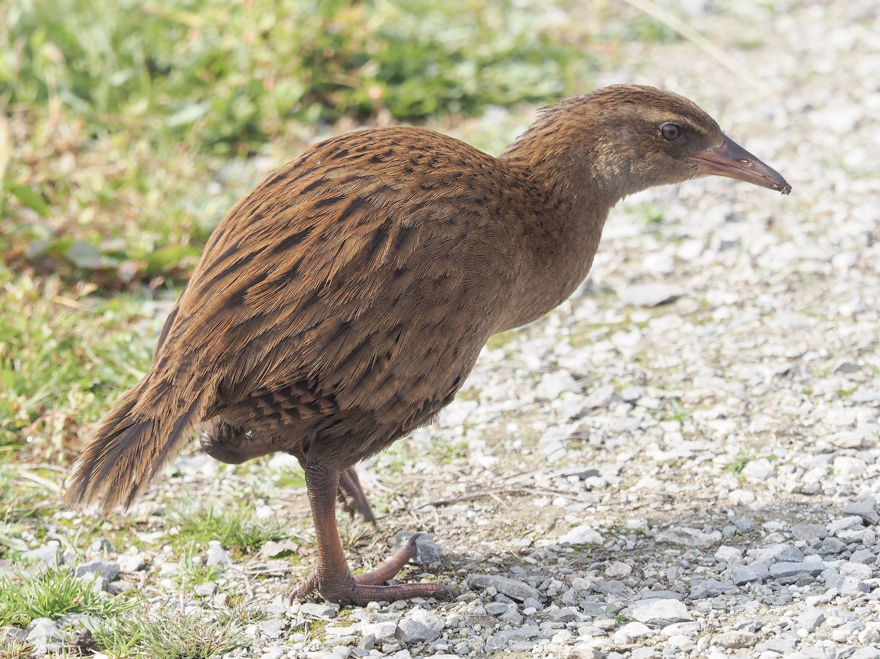
>

Slide 5
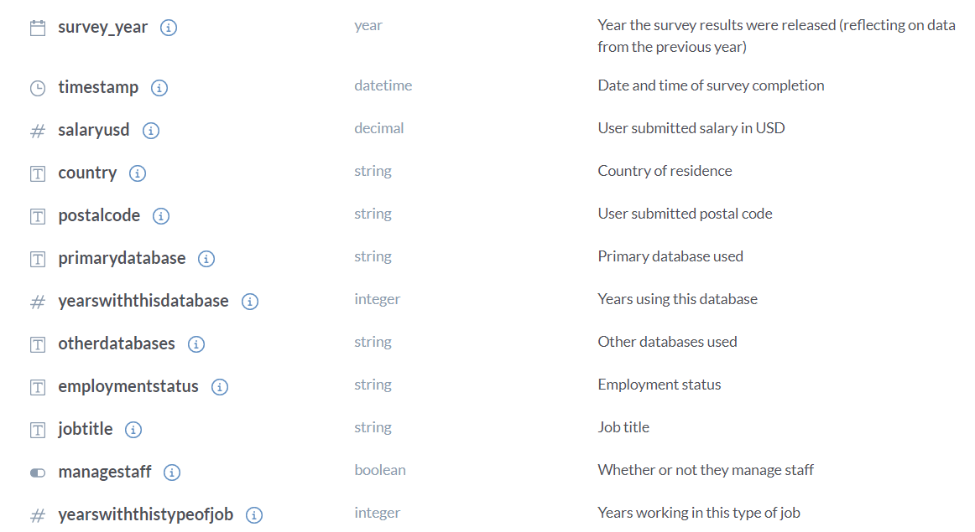
Our data

Slide 6
Our data

Slide 7
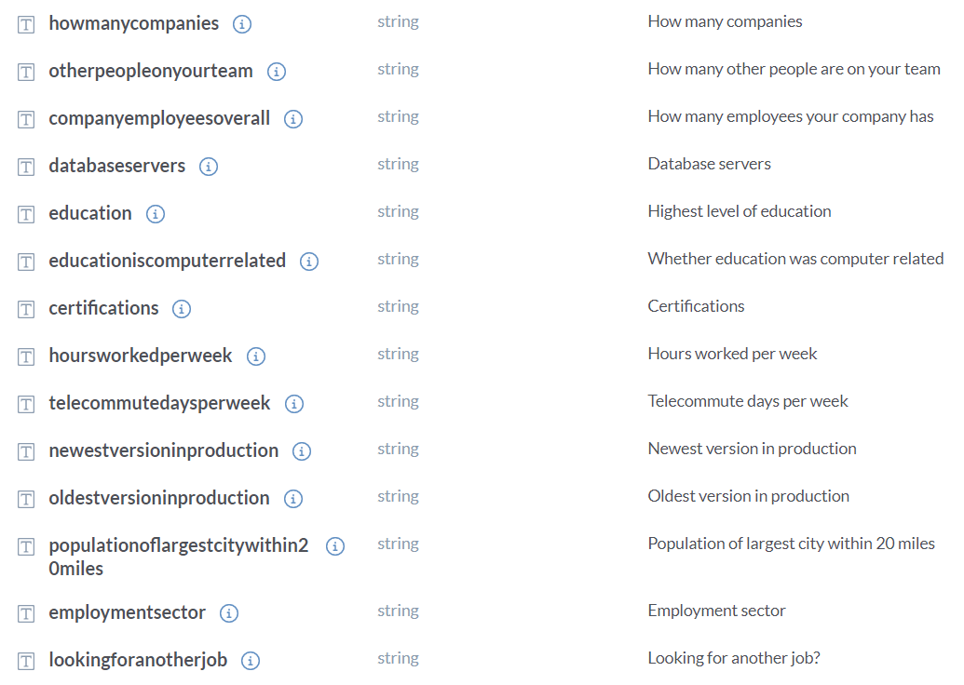
Our data

Slide 8
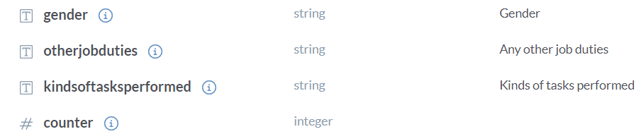
Our data

Slide 9
Preprocessing
Remove useless/largely missing/irrelevant attributes
Attribute | Rationale
Survey Year | Date is irrelevant
Timestamp | Date is irrelevant
Postal Code | International, Postal code is irrelevant
Other Databases | Mixed data with multiple select
Database Servers | Mixed data with multiple select

Slide 10
Preprocessing
Remove useless/largely missing/irrelevant attributes
Counter | Useless
CompanyEmployeesOverall | Data is not fully numeric, 76% of data is missing
EducationIsComputerRelated | 46% of attribute is missing
NewestVersionInProduction | Mixed data with multiple select
PopulationOfLargestCityWithin20Miles | 58% of attribute is missing

Slide 11

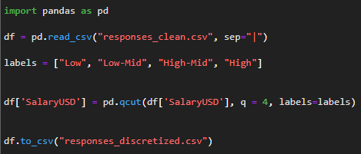
Preprocessing
Discretizing

Slide 12
Preprocessing
Low | [13, 65,942.5)
Low-Mid | [65,942.5, 91,000)
High-Mid | [91,000, 115,650)
High | [115,650, 1,850,000]
Equal Class Size = Accuracy is viable

Slide 13
Preprocessing
Removing unrealistic outliers
Remapping data values for WEKA
Employment
Private business | PB
Education (K-12, college, university) | E
State/province government | SG
Local government | LG
Non-profit | NP
Federal government | FG
Student | T
How many employees does your company have overall? | Remove unrealistic outliers: 1e+8

Slide 14
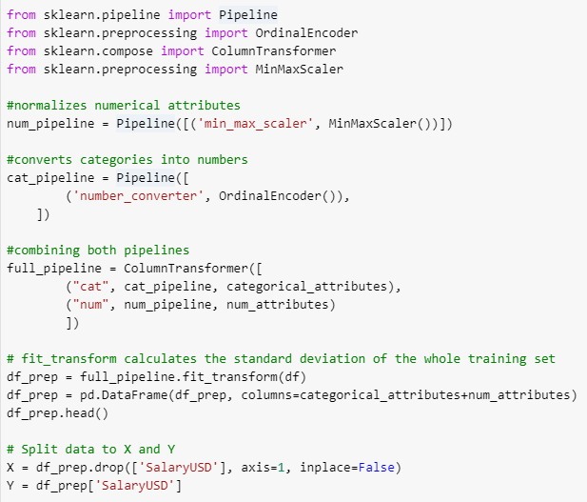
Preprocessing
scikit-learn

Slide 15
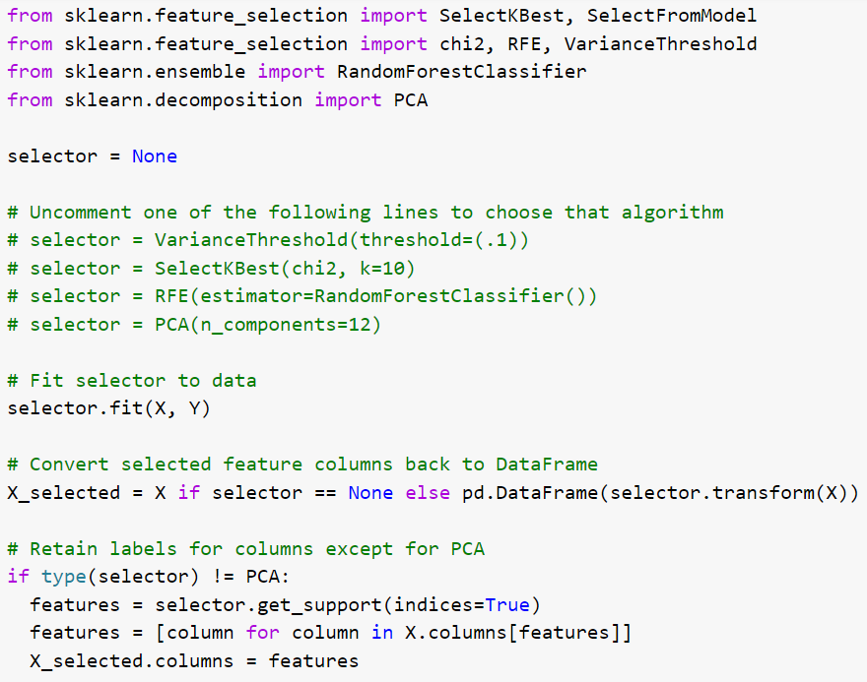
Attribute Selection
VarianceThreshold
Chi-squared
RFE + RandomForest
PCA
Notes:
Rfe = recursive feature elimination
Pca = principal component analysis

Slide 16
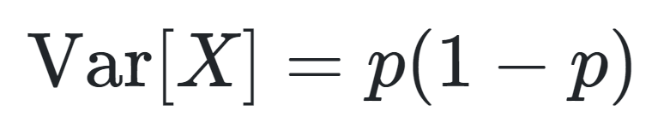
Preprocessing
VarianceThreshold

Slide 17
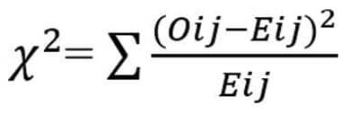
Preprocessing
Chi-squared

Slide 18
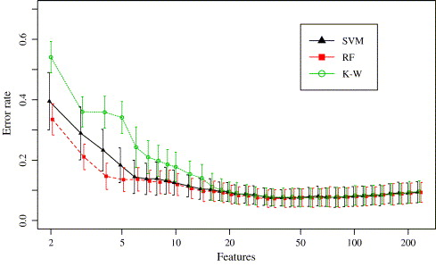
Preprocessing
Recursive Feature Elimination + RandomForest

Slide 19
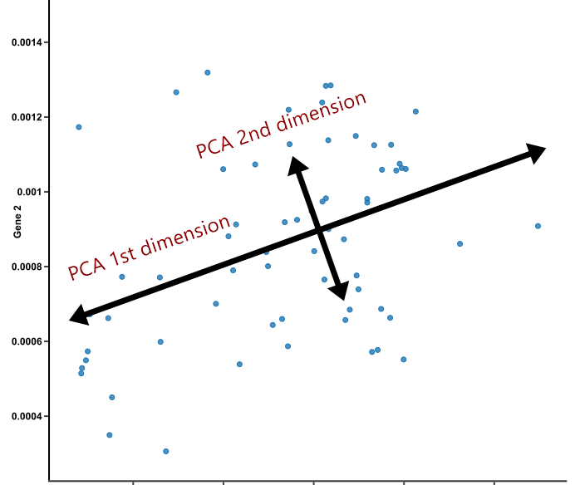
Preprocessing
Principal Component Analysis

Slide 20

Classification
Decision Trees
Random Forest Classifiers
Naive Bayes Gaussian Classifier
KNeighborsClassifiers

Slide 21
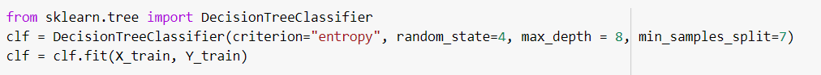
Decision Trees - For the decision tree model, we used the entropy model, along with a max_depth of 8 to prevent overfitting. Also, in our splits for the decision trees, we split it into a maximum of 7 different things, to make sure no section was thoroughly overfit. Other than this, the default parameters of Decision Tree Classifier were used for sklearn.

Slide 22
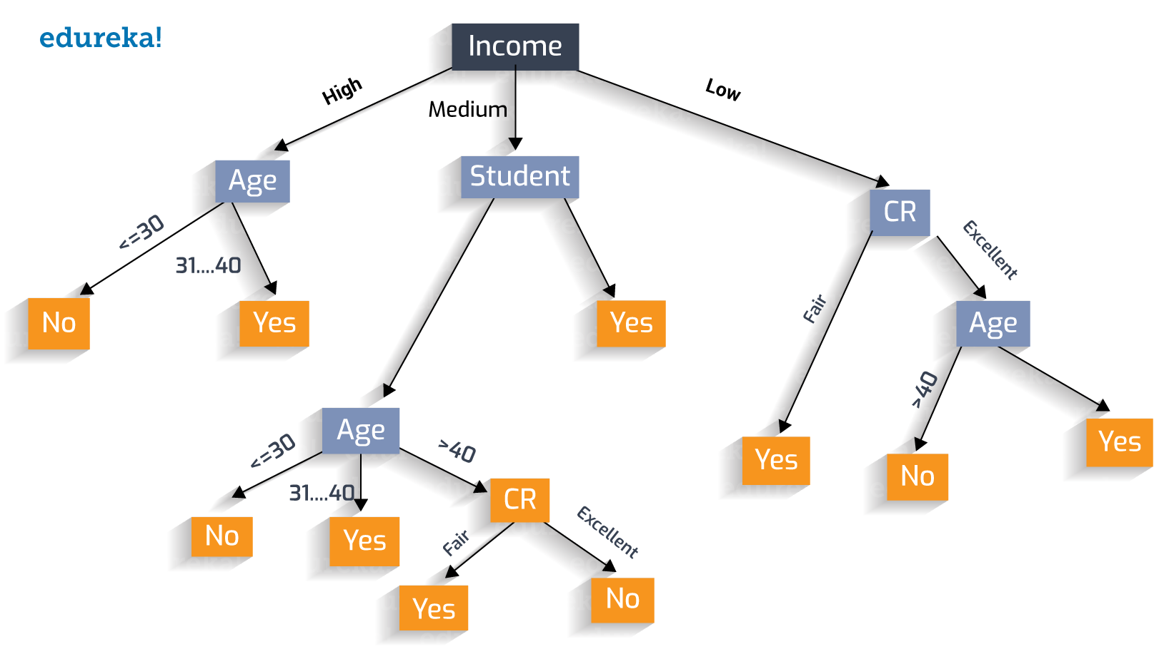

Slide 23
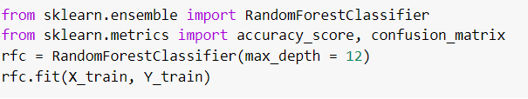
Random Forest Classifier - For this classifier, we used a similar parameter with decision trees, but instead set the max_depth to be 12, because it was generalizing too much before that. The following code shows how to recreate the random forest classifier.

Slide 24


Slide 25
Naive Bayesian Gaussian Classifier - This classifier wasn’t doing well no matter how we changed the parameters, so we ran the default parameters with the following code.

Slide 26
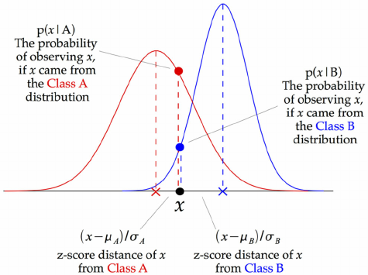
Notes:
This is a variant of Naive Bayes which supports continuous values and has an assumption that each class is normally distributed.

Slide 27
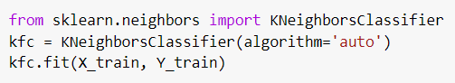
KNeighborsClassifiers - We tried this classifier as it seems interesting to group our data into clusters. For this one as well, we simply used the default classifier, and in terms of accuracy, it was in between Naive Bayesian and Decision Trees/Random Forest.

Slide 28
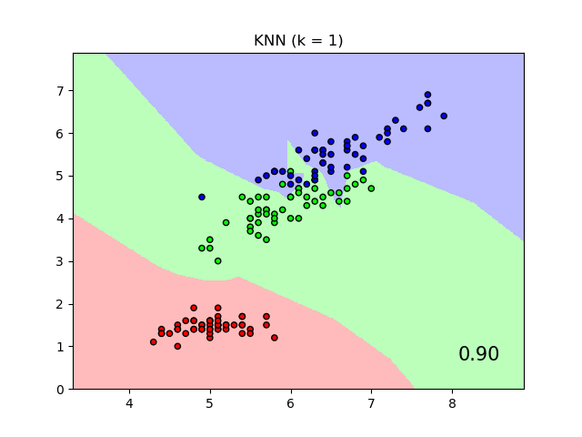

Slide 29
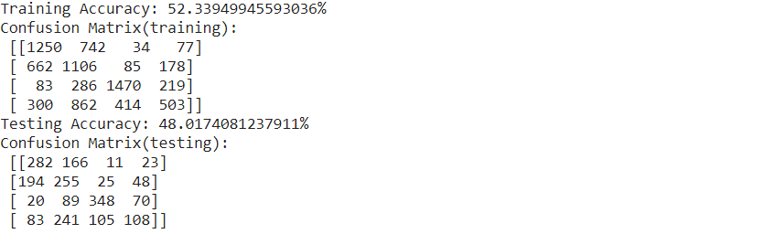
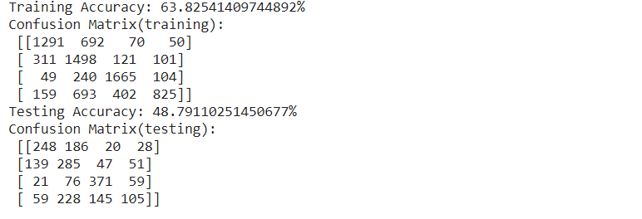
VarianceThreshold
Decision Trees Random Forest

Slide 30
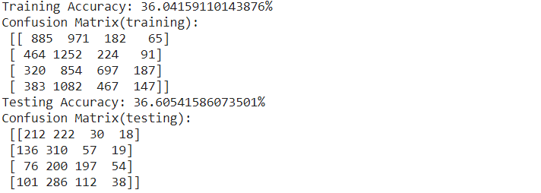
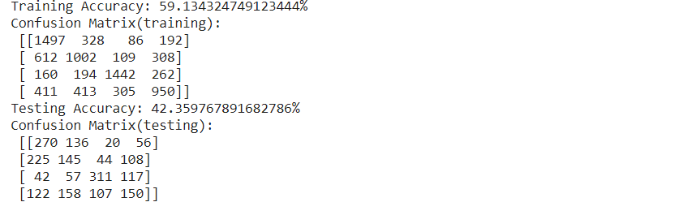
VarianceThreshold
Naive Bayes Gaussian Classifier KNeighborsClassifiers

Slide 31
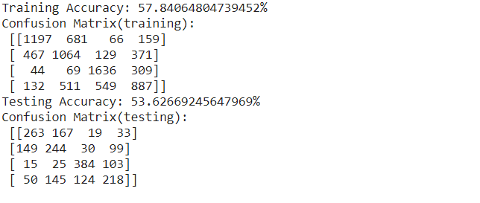
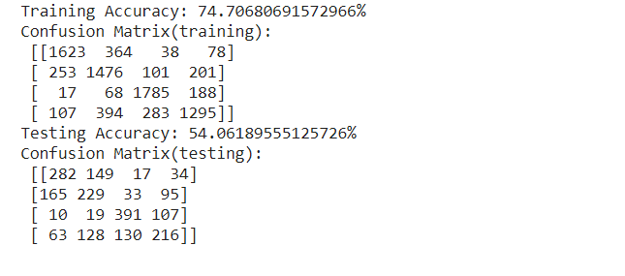
Chi-Squared
Decision Trees Random Forest

Slide 32
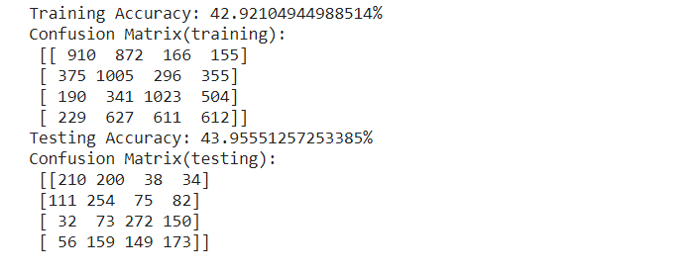
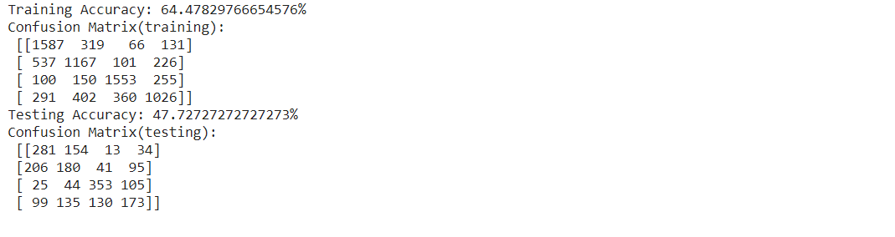
Chi-Squared
Naive Bayes Gaussian Classifier KNeighborsClassifiers

Slide 33
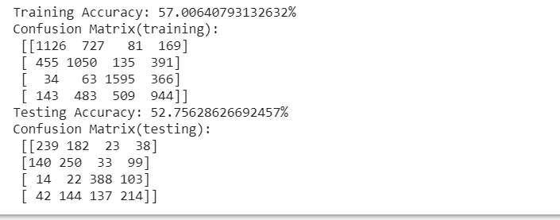
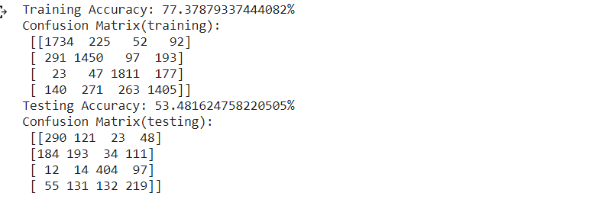
RFE+RandomForest
Decision Trees Random Forest

Slide 34
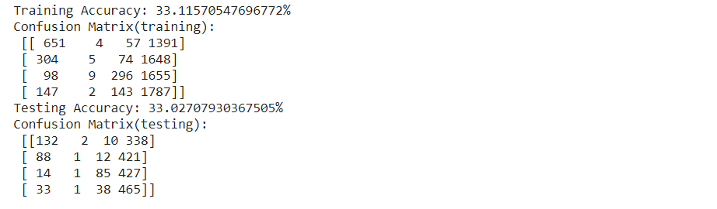
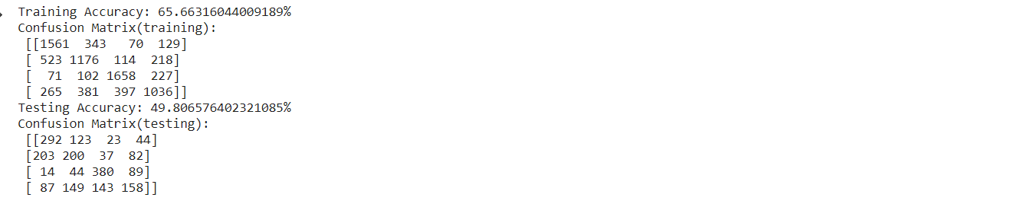
RFE+RandomForest
Naive Bayes Gaussian Classifier KNeighborsClassifiers

Slide 35
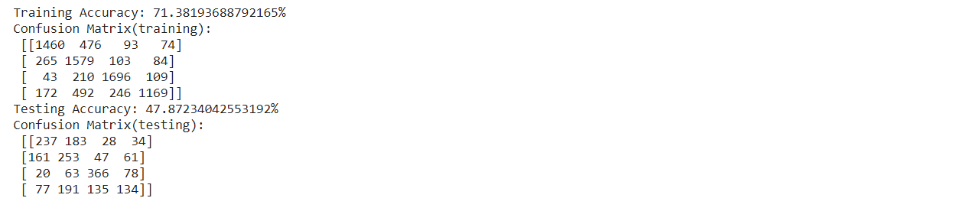
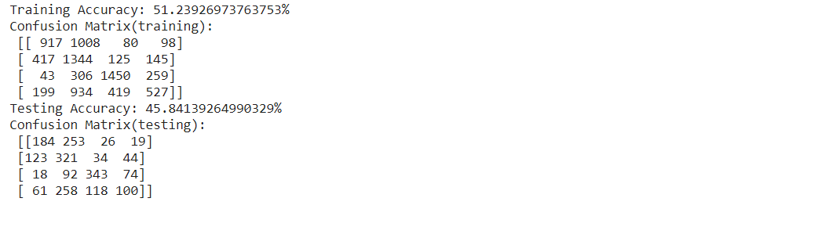
PCA
Decision Trees Random Forest

Slide 36
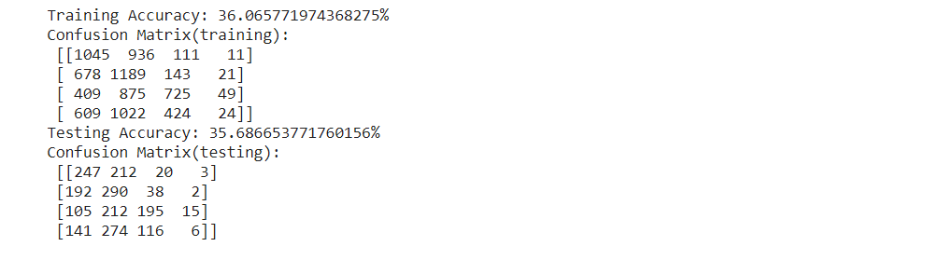
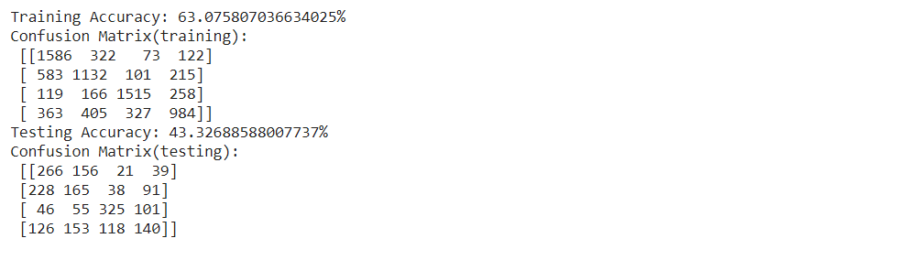
PCA
Naive Bayes Gaussian Classifier KNeighborsClassifiers

Slide 37
Analysis
Best Classifier: No Attribute Selection + RandomForest
Acc: 54.9%
Worst Classifier: RFE/RF + Gaussian Naive Bayes
33.3%
Average Classifier Ranking
RandomForest
KNeighbors
Decision Trees
Gaussian Naive Bayes
Notes:
The following screenshots show the accuracy of our model if we don’t use attribute selection algorithms. We can see that Random Forest gives us the best accuracy with an accuracy of 54.9%, while NaiveBayes gives us an accuracy of only 35%. It's important to note that NaiveBayes may be failing due to the assumption that all the attributes are considered independent of each other. We can only notice that Decision Trees and Random Forest Classifiers are doing really well comparatively for this dataset, meaning that entropy is a good measure of how to split the dataset. Furthermore, accuracy was also a good measure to determine how great our model was doing as the classes we discretized into had a relatively equal amount of instances.

